Slide 1














A Deployable Decision Service
John Langford, Microsoft Research NYC

Slide 2
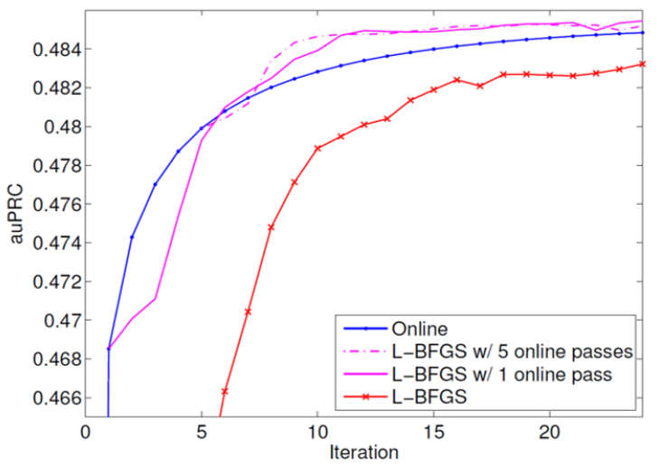
??

Slide 3


Slide 4
Infovore = Information based lifeform
Repeatedly:
Sense the world.
Act.
Observe outcome.
Goal: Optimize (2) for (3)

Slide 5

Ex: Which news?
Repeatedly:
Observe features of user+articles
Choose a news article.
Observe click-or-not
Goal: Maximize fraction of clicks

Slide 6



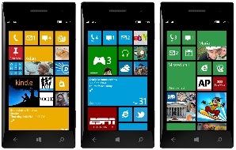






Pervasive applications
Exploration needed
everywhere

Slide 7
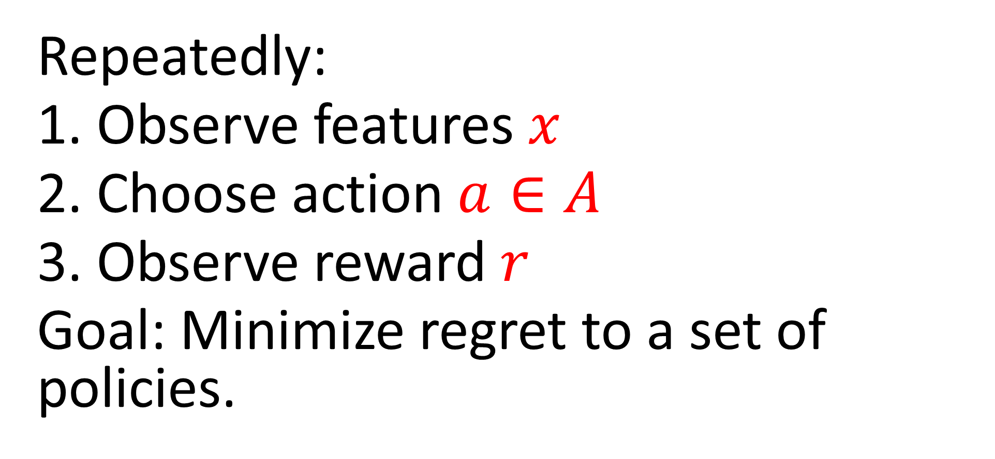
Contextual Bandits
Repeatedly:
Observe features $x$
Choose action $a∈A$
Observe reward $r$
Goal: Minimize regret to a set of policies.

Slide 8
The History of Contextual Bandits
Statistically efficient algorithm [ACFS ‘95].
Reduce to SL [Z ’03, BL ’08, DLL ‘11]
Named, efficient [LZ ‘07]
Computation + Statistical optimality [DHKKLRZ ’11, AHKLLS ‘11]
Nonstationary policy evaluation [DELL ‘15]
Deployable [ABCHLLLMORSS ‘16]

Slide 9


Exploration
Policy

Slide 10
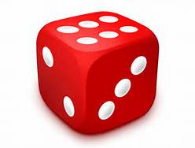
Exploration
Randomization
Policy

Slide 11

Exploration
Randomization
Policy

Slide 12
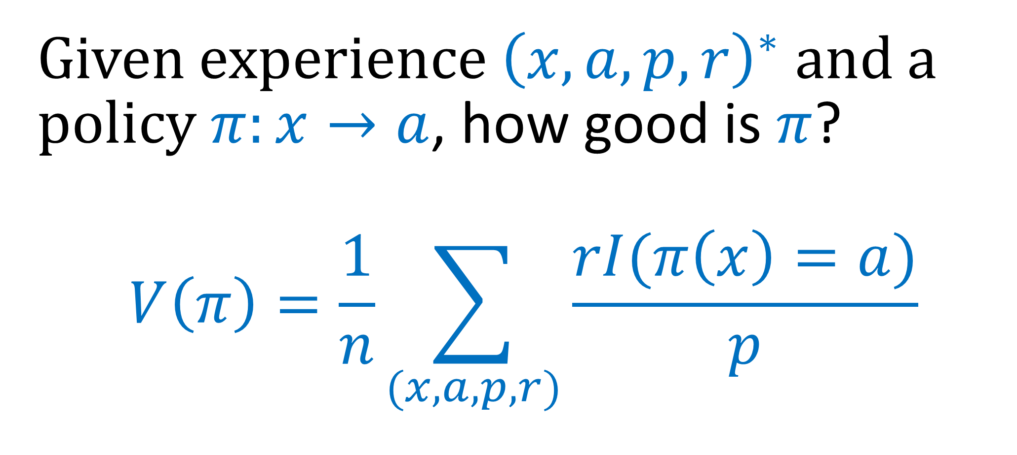
A Foundation: Multiworld Testing
Given experience ${\left(x,a,p,r\right)}^{∗}$ and a policy $π:x→a$, how good is $π$?
$$V\left(π\right)=\frac{1}{n}\sum_{(x,a,p,r)}{\frac{rI(π\left(x\right)=a)}{p}}$$

Slide 13
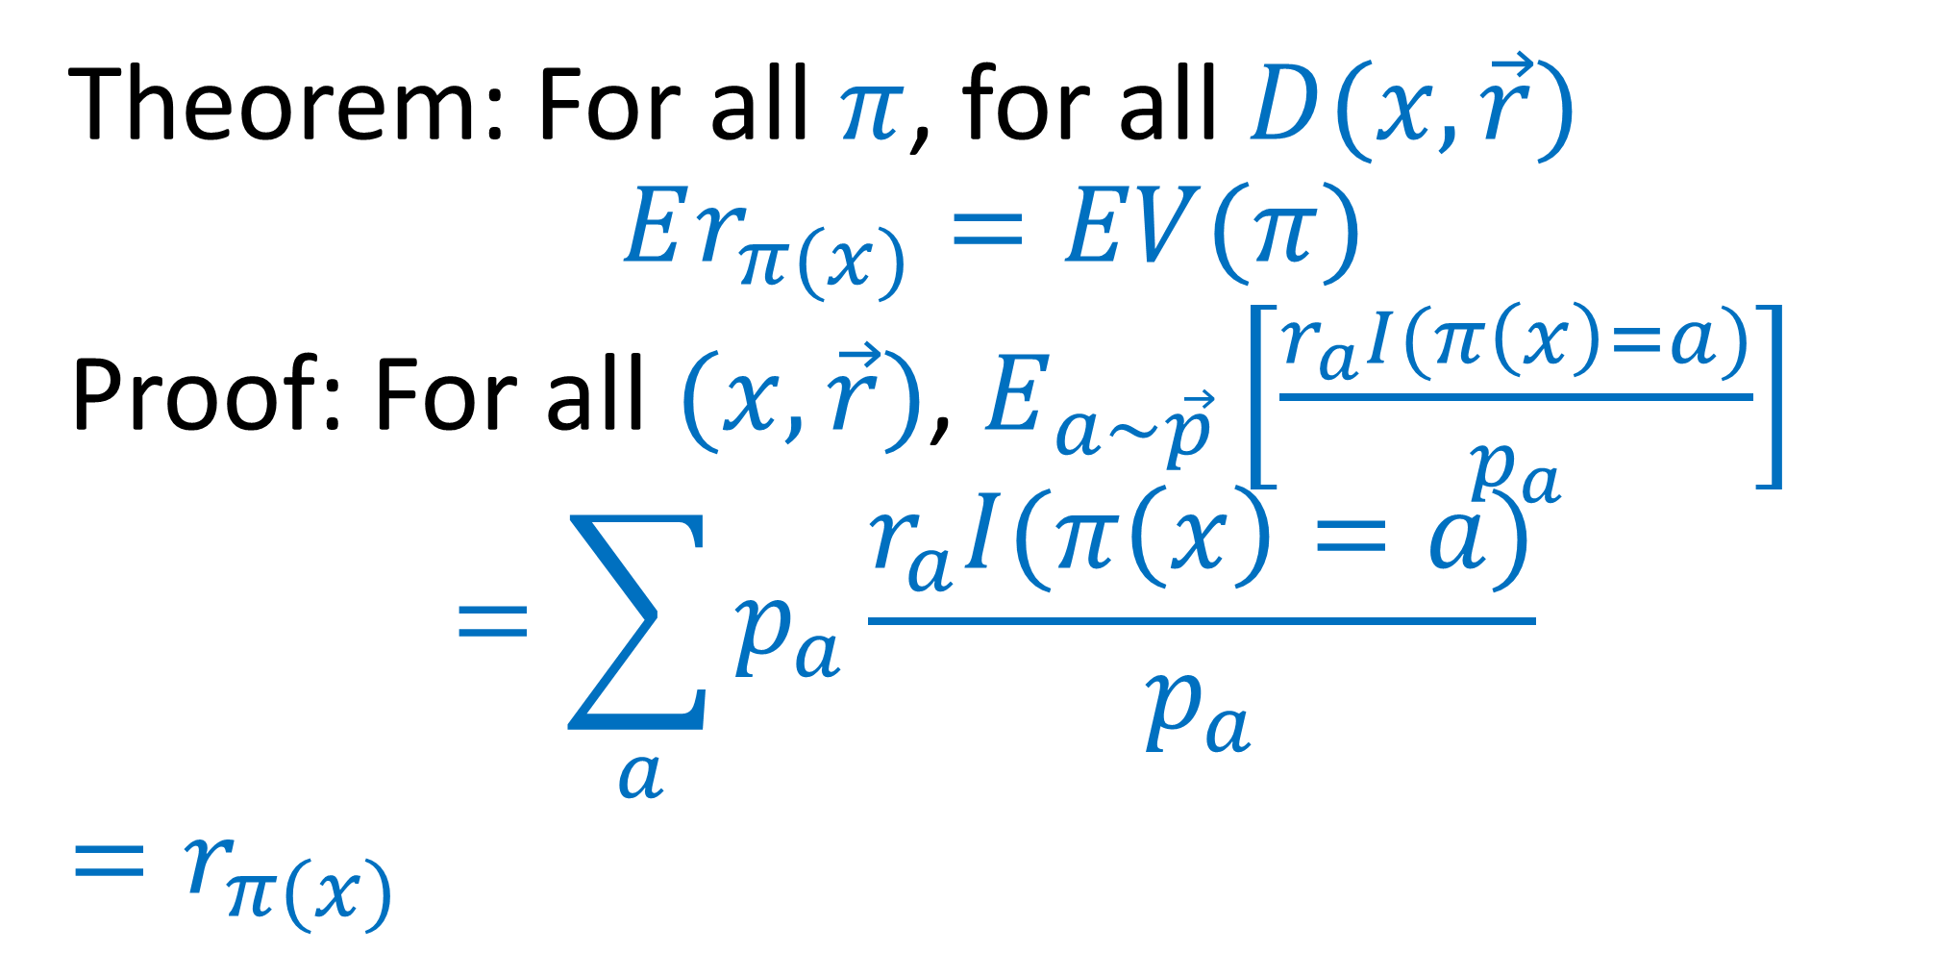
What do we know about MWT?
Theorem: For all $π$, for all $D(x,\vec{r})$
$$Er_{π(x)}=EV(π)$$
Proof: For all $(x,\vec{r})$, $E_{a∼\vec{p}}\left[\frac{r_{a}I(π\left(x\right)=a)}{p_{a}}\right]$
$$=\sum_{a}{p_{a}\frac{r_{a}I(π\left(x\right)=a)}{p_{a}}}$$
$=r_{π(x)}$

Slide 14
What could possibly go wrong?
Different parts = Different people
Faulty logging
  Final action, not choice
  Just choice, not probability
  Features not logged
Runtime incompatible with ML
  Downstream overrides
  Using probability as feature
Explore
Log
Deploy
Learn

Slide 15


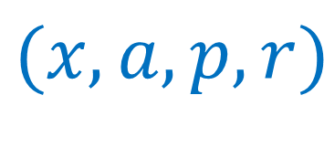
Multiworld Testing Decision Service
Policy $π$
context
Client Library
Online Learning
App
decision
Offline
Or Web API
Learning
reward
$$(x,a,p,k)$$
$\left(r,k\right)$
Join
Server
$$(x,a,p,r)$$

Slide 16
Multiworld Testing Decision Service
Policy $π$
Explore
context
Client Library
Online Learning
App
decision
Offline
Or Web API
Learning
reward
$$(x,a,p,k)$$
$\left(r,k\right)$
Join
Server
$$(x,a,p,r)$$

Slide 17
Multiworld Testing Decision Service
Policy $π$
context
Client Library
Online Learning
App
decision
Offline
Or Web API
Learning
reward
$$(x,a,p,k)$$
$\left(r,k\right)$
Join
Server
$$(x,a,p,r)$$
Log

Slide 18
Multiworld Testing Decision Service
Policy $π$
Learn
context
Client Library
Online Learning
App
decision
Offline
Or Web API
Learning
reward
$$(x,a,p,k)$$
$\left(r,k\right)$
Join
Server
$$(x,a,p,r)$$

Slide 19
Multiworld Testing Decision Service
Deploy
Policy $π$
context
Client Library
Online Learning
App
decision
Offline
Or Web API
Learning
reward
$$(x,a,p,k)$$
$\left(r,k\right)$
Join
Server
$$(x,a,p,r)$$

Slide 20
Multiworld Testing Decision Service
Policy $π$
context
Client Library
Online Learning
Offline Learn
App
decision
Offline
Or Web API
Learning
reward
$$(x,a,p,k)$$
$\left(r,k\right)$
Join
Server
$$(x,a,p,r)$$
Data

Slide 21
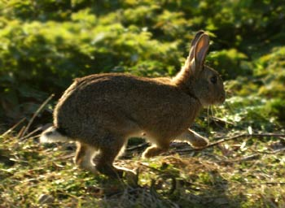
Learning / Multiworld Testing
Open Source in Vowpal Wabbit
Policy Optimization beyond the reach of A/B testing

Slide 22


Slide 23


MSN Results
10s of millions of users
5 minute model update frequency
> 25% increase in clicks
(without much tuning)
…

Slide 24
Keys to Success
Contextual Bandits: Bias kills
Data Lifecycle support: Bugs kill
Reproducibility: Bugs kill
Online Learning: Nonstationarity!

Slide 25
Deployable Decision Service
http://aka.ms/mwt
http://arxiv.org/abs/1606.03966
http://hunch.net/~vw

