Slide 1
Can Criminal Justice Risk Assessments Be Accurate, Transparent, and Fair At The Same Time?
Richard Berk
Department of Statistics
Department of Criminology
University of Pennsylvania
with Michael Kearns, Aaron Roth
Cary Coglianese and others

Slide 2
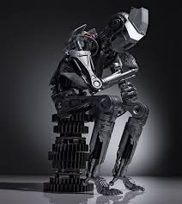
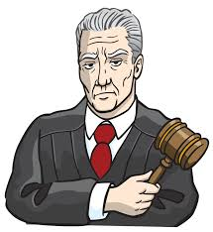
Compared to What?
Current Practice

Slide 3
We start with public safety — which means we start with concern about crime victims
3 teens, believed targeted, older man all shot outside SW Philly bar
Victim stabbed at Old City bar dies, homicide tally rises
Homeless man's death ruled a homicide
Woman pulled from car, raped; man arrested
Bearded man sought in 6 armed Philly store robberies
Police: Man who called himself 'Gotti' arrested in 2 rapes

Slide 4
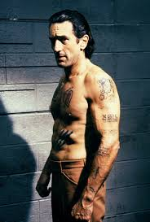
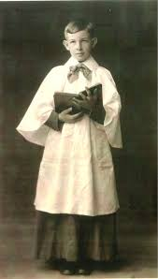
“Future Dangerousness”
versus
Intervene Where We Can
1. Arraignments
2. Sentencing
3. Prison Safety
4. Parole
5. Supervision

Slide 5
Machine Learning With Training Data
Classification with Tools like Boosting, Random Forests and Support Vector Machines
many
+
_
+
+
_
+
_
+
+
+
_
_
+
_
_
High Risk Region
Number of Charges
+
+
+
_
_
_
Low Risk Region
_
_
+
+
_
+
_
+
0
0
many
Number of Priors

Slide 6
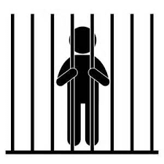
Two Kinds of Mistakes

Slide 7
Unavoidable Tradeoffs
Which mistake is worse and how much worse?
Detain
Release
Tune

Slide 8
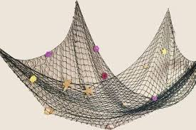
Tradeoff Implications
Ratio of False Negatives and False positives
more high risk offenders
but more low risk offenders
Tradeoffs must be built into the prediction
algorithm and are policy decisions.

Slide 9
Training Data Results
One False Negative is
Worth Three False Positives
 | Forecast Arrest | Forecast No arrest
Actual Arrest | 400 | 100 False Negatives
Actual No Arrest | 300 False Positives | 300

Slide 10
Fairness In The Predictors Used
Race
Zip Code
Age
RISK
Prior Record
Gender
Current Changes
Recency of Crime
Age at First Arrest
Accuracy/Fairness Tradeoff
…..

Slide 11
Some Accuracy Fairness Tradeoffs
Prior Record Alone
Prior
Record
Arrest
Race and Prior
Record Together
Race
Irrelevant
Race Alone

Slide 12
Fairness Tradeoffs For Black (N=13,396)
and White (N =6604)
Offenders at Arraignment
Berk, Hoda, Jabbari, Kearns and Roth, 2017
 | Base Rate No Violence | Positive Predictive Value | False Negative Rate | False Positive Rate
Blacks | 0.89 | 0.93 | 0.49 (incorrect nonviolence) | 0.24 (incorrect violence)
Whites | 0.94 | 0.94 | 0.93 (incorrect nonviolence) | 0.02 (incorrect violence)
Forecasting Errors Make Blacks
Look More Dangerous

Slide 13
But do we “level up” or “level down”?
Example:
1. Longer sentences to whites so that are treated like blacks?
2. Shorter sentences to blacks so that they are treated like whites?
3. Split the difference?
Whites:
6.5 years
?
Blacks:
7.8 years

Slide 14
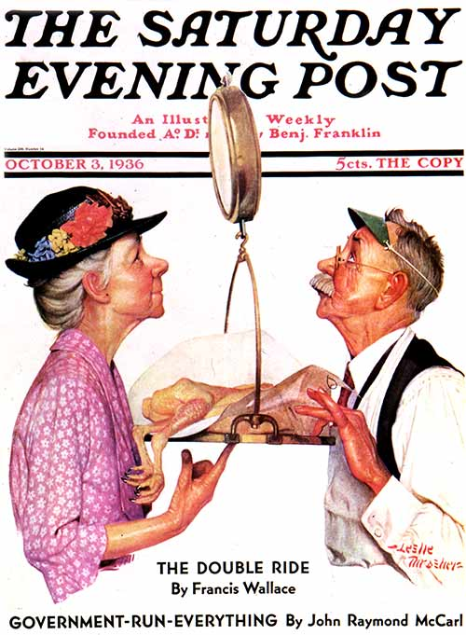

Slide 15
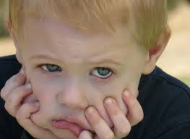
Conclusion
You Can’t Have It All.

